Slide 1

Final Project
Elsherif Mahmoud
ECEN 210

Slide 2
Overview
App Walkthrough
Code structure

Slide 3
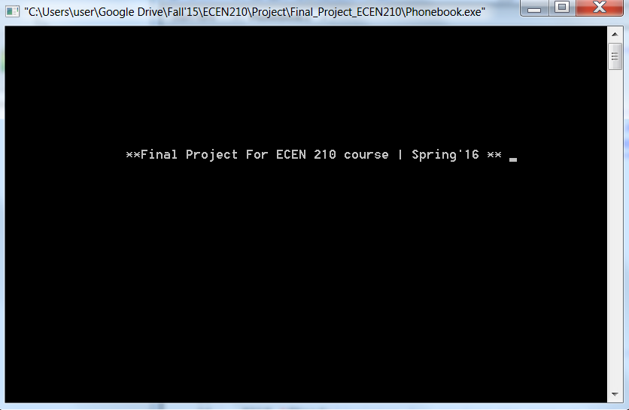

Slide 4
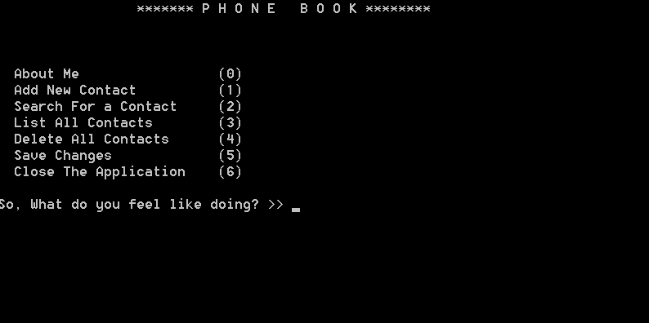

Slide 5
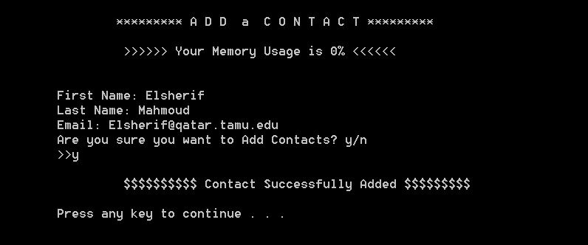

Slide 6
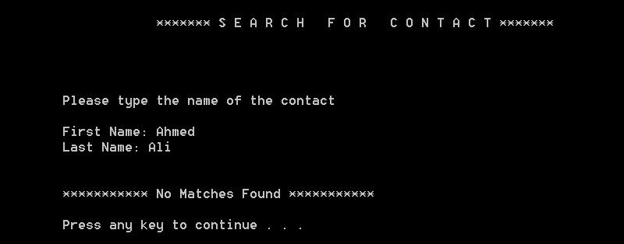

Slide 7
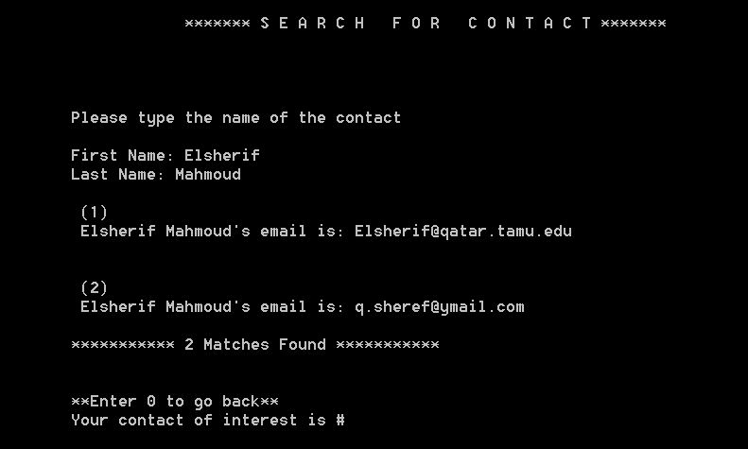

Slide 8
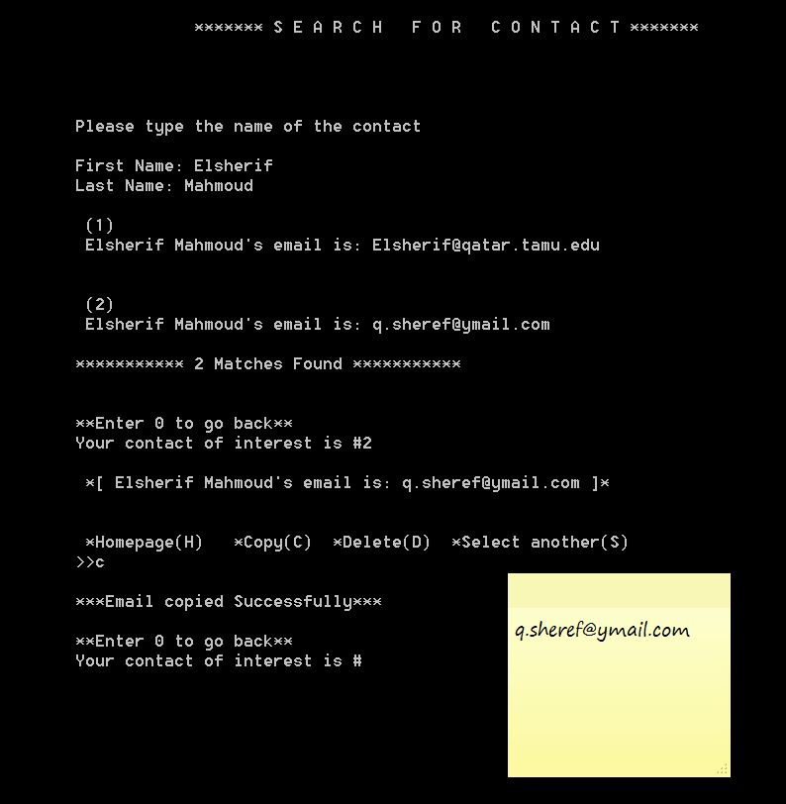

Slide 9
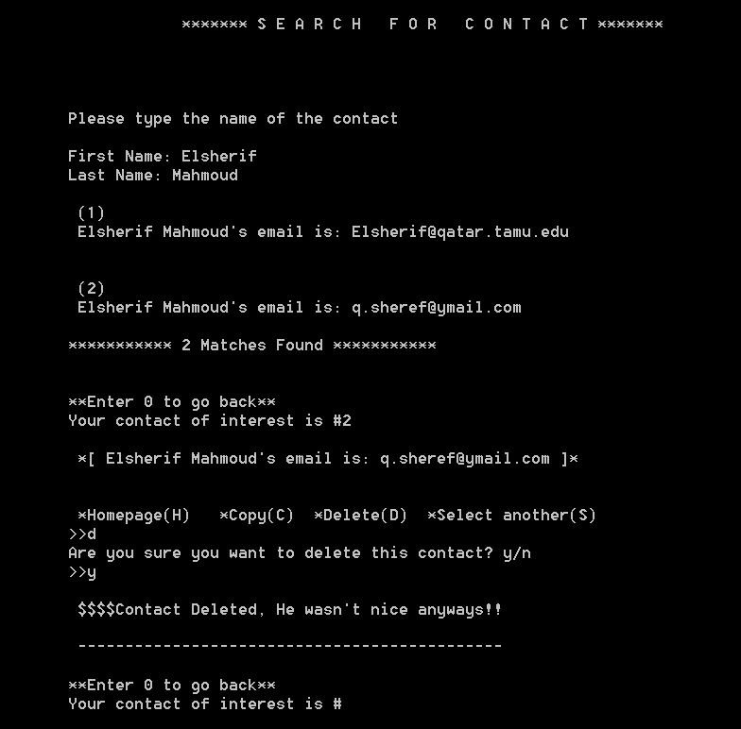

Slide 10
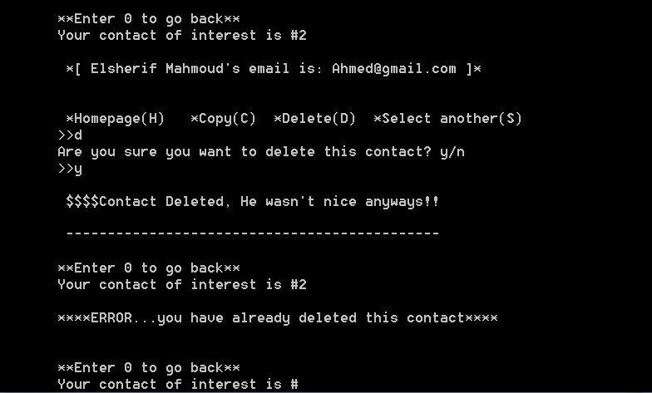

Slide 11
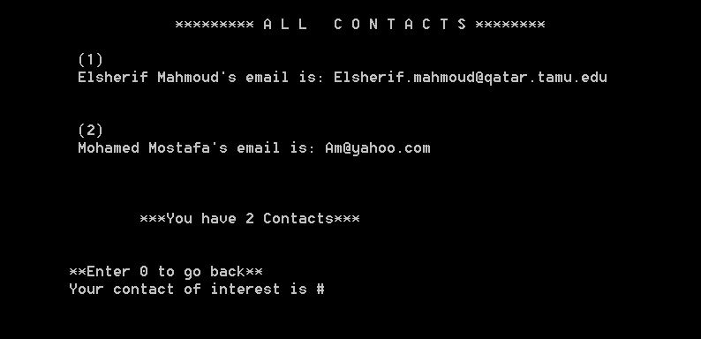

Slide 12
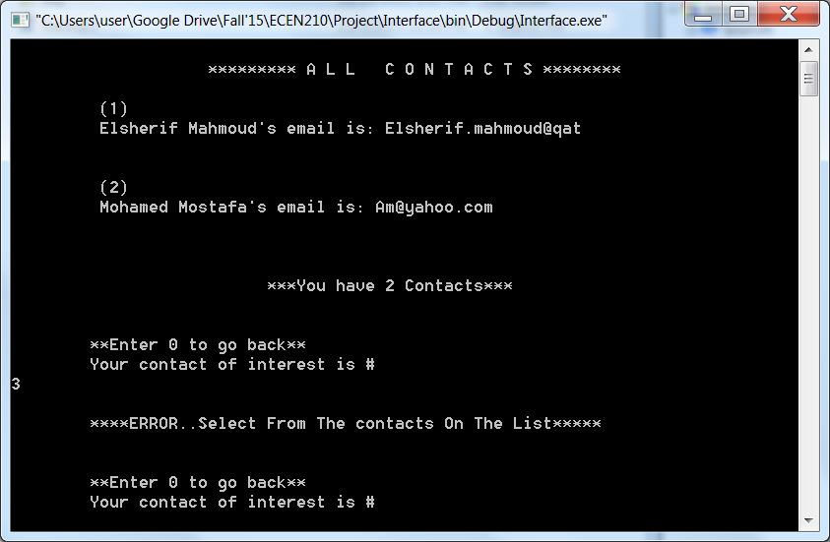

Slide 13
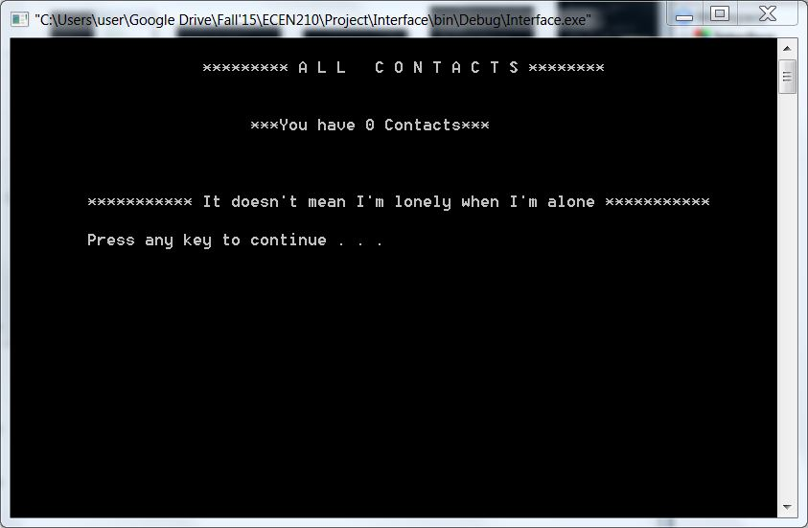

Slide 16
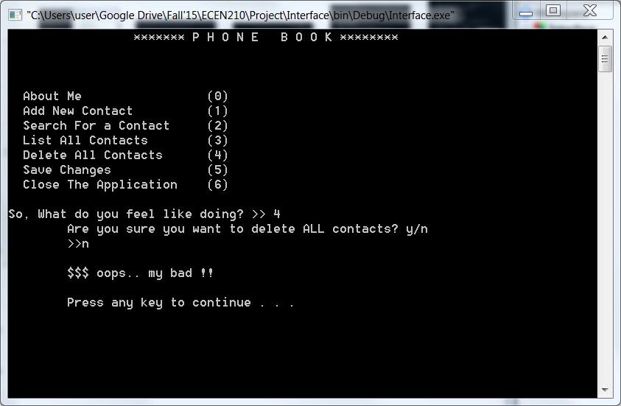

Slide 17
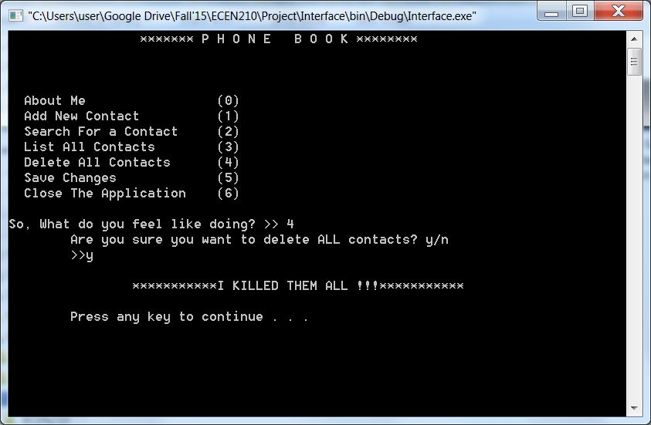

Slide 18
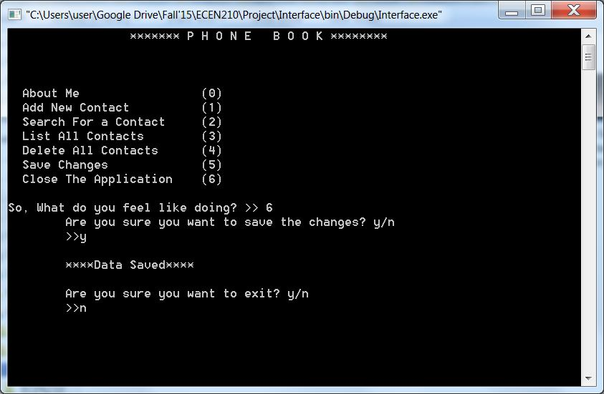

Slide 19
Functions
User Experience
Taskforce
Checkers
Assigners
Implementers
DeleteContact
AddContact
Options
Main
Transition
Delay
Scan_int
AreYouSure
Header

Slide 20
Phonebook_Contact Data Type.
1
Elsherif
Mahmoud
q.sheref@ymail.com
1
Hossam
Yasser
Hossam@gmail.com
0
Somebody
SomebodyElse
email@example.com
Exist signal
First Name
Last Name
Email Address

Slide 21
Header

Slide 22

Transition
Dynamic Transition Message:
Project Title
Loading
Closing

Slide 23
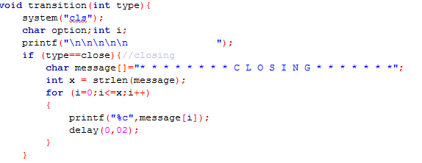

Slide 24
Delay
This function freezes the compiler for specified time.
It takes two inputs (number of integer seconds, fractional seconds)
e.g. delay(1,33) delays the program by 1.33 seconds

Slide 25
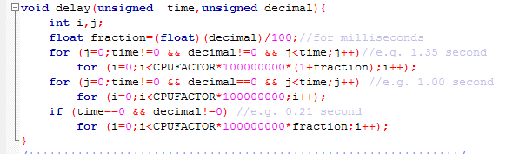

Slide 26
Main
Intitalize the Data Structure
Load the contact lists
Initialize the number of contacts
Prompt the user Input
Call Functions (Assign Tasks)

Slide 27
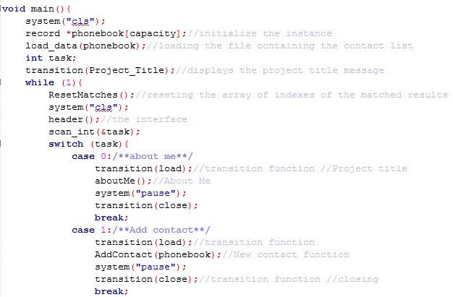

Slide 28
AddContact
This function adds a new contact to the array of phonebook
It asks the user to enter the First and Last Names as well as the email address.
It then creates a signal of existents (x.exists=1)

Slide 29
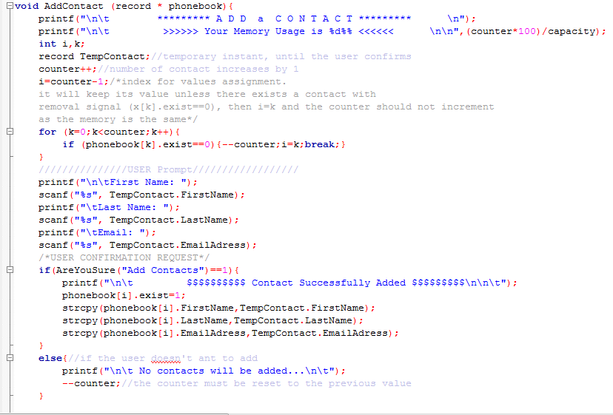

Slide 30
SearchForContact
This function searches for contact by matching first and last names [CASE SENSITIVE]
It takes phonebook array as an input.
Searches only among exisiting contacts (x.exist==1)

Slide 31
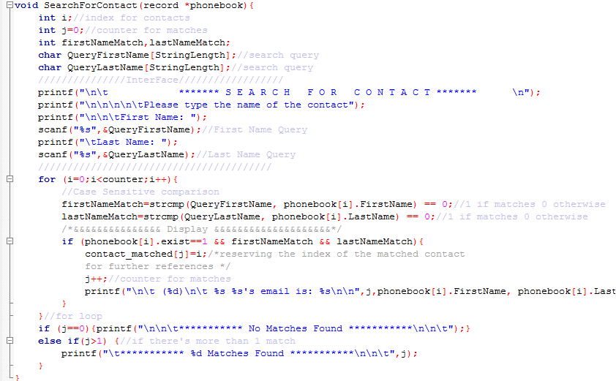

Slide 33
Options
This function is executed after listing All or searched contacts.
The user is asked to select the contact of interest.
The user is then asked to select the action to be performed on the contact:
1)go to homepage
2)Copy the contact's email to clipboard
3)Delete the contact
4)Back to the list of contact

Slide 34
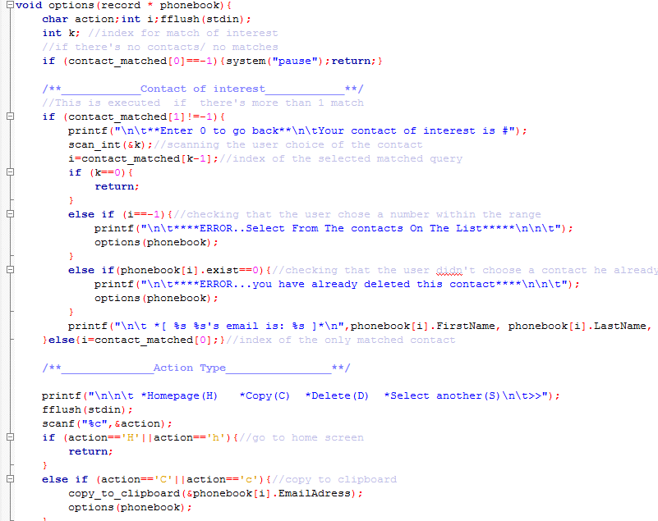

Slide 35
DeleteContact
This function deletes specific contact.
It takes two inputs
the phonebook instance array
the specific index of the contact.
It then sends a removal signal by assigning 0 to "exist" the parameter (i.e.x[i].exist=0)
1
Somebody
SomebodyElse
email@example.com
0
Somebody
SomebodyElse
email@example.com

Slide 36
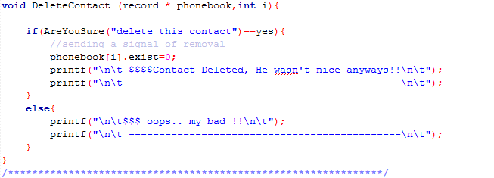

Slide 37
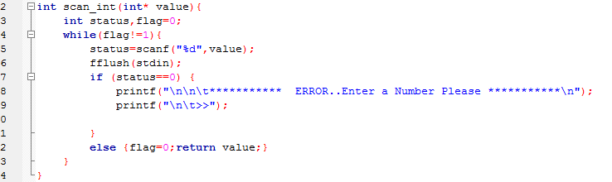
Scan_int
This function checks the scanned integers
Performs error analysis

Slide 38
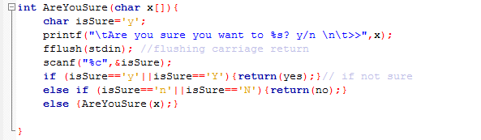
AreYouSure
Checks if the user is sure of the operation he commanded
It takes the message to be displayed as an input
i.e. AreYouSure(“Delete All Contacts”);

Slide 40
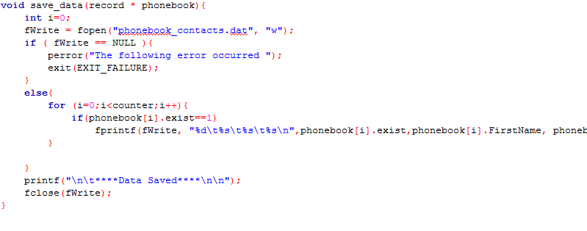
Save_Data
This function stores the updated contacts list in a file ready for retrieval after closing the application.
It only stores the contacts which have existence signal of 1 (x.exist=1)

